Slide 1
Eco Church
Bristol Diocese
David Morgan – A Rocha UK
14 April 2018
Notes:
Eco Church is a practical framework to enable churches of all denominations to care for God’s earth through every aspect of church life.
How many of you have tried out the Eco Church questionnaire?

Slide 2
Eco Church is designed :
For frustrated eco-enthusiasts
To provide a “tool for the journey”
Not an award to show off!
To provide useful resources to facilitate churches’ eco journeys
Notes:
Is that you?

Slide 3
Overall Aim
Caring for God’s creation to be a part of ‘normal Christian life’
i.e. for everyone

Slide 5
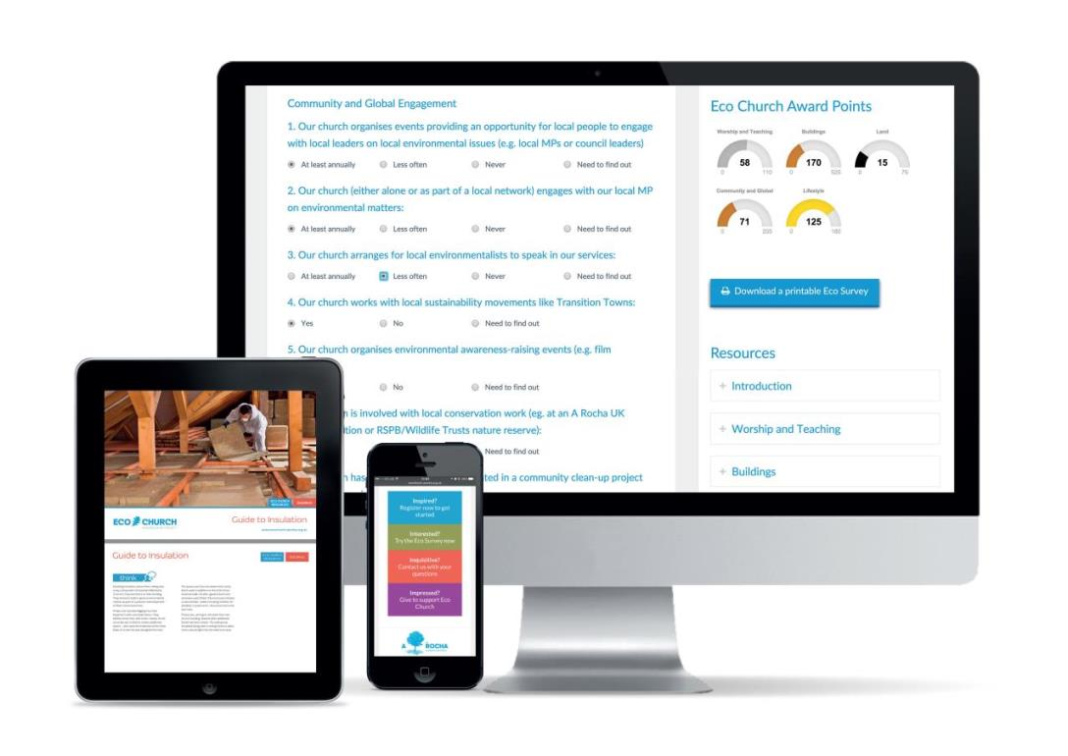

Slide 6
Eco Survey
Worship and teaching
Management of church buildings
Management of church land
Community and global engagement
Lifestyle
Notes:
Need to do all sections
Ideally teaching first as flows from what we believe
You will find that you are already doing more than you think

Slide 7
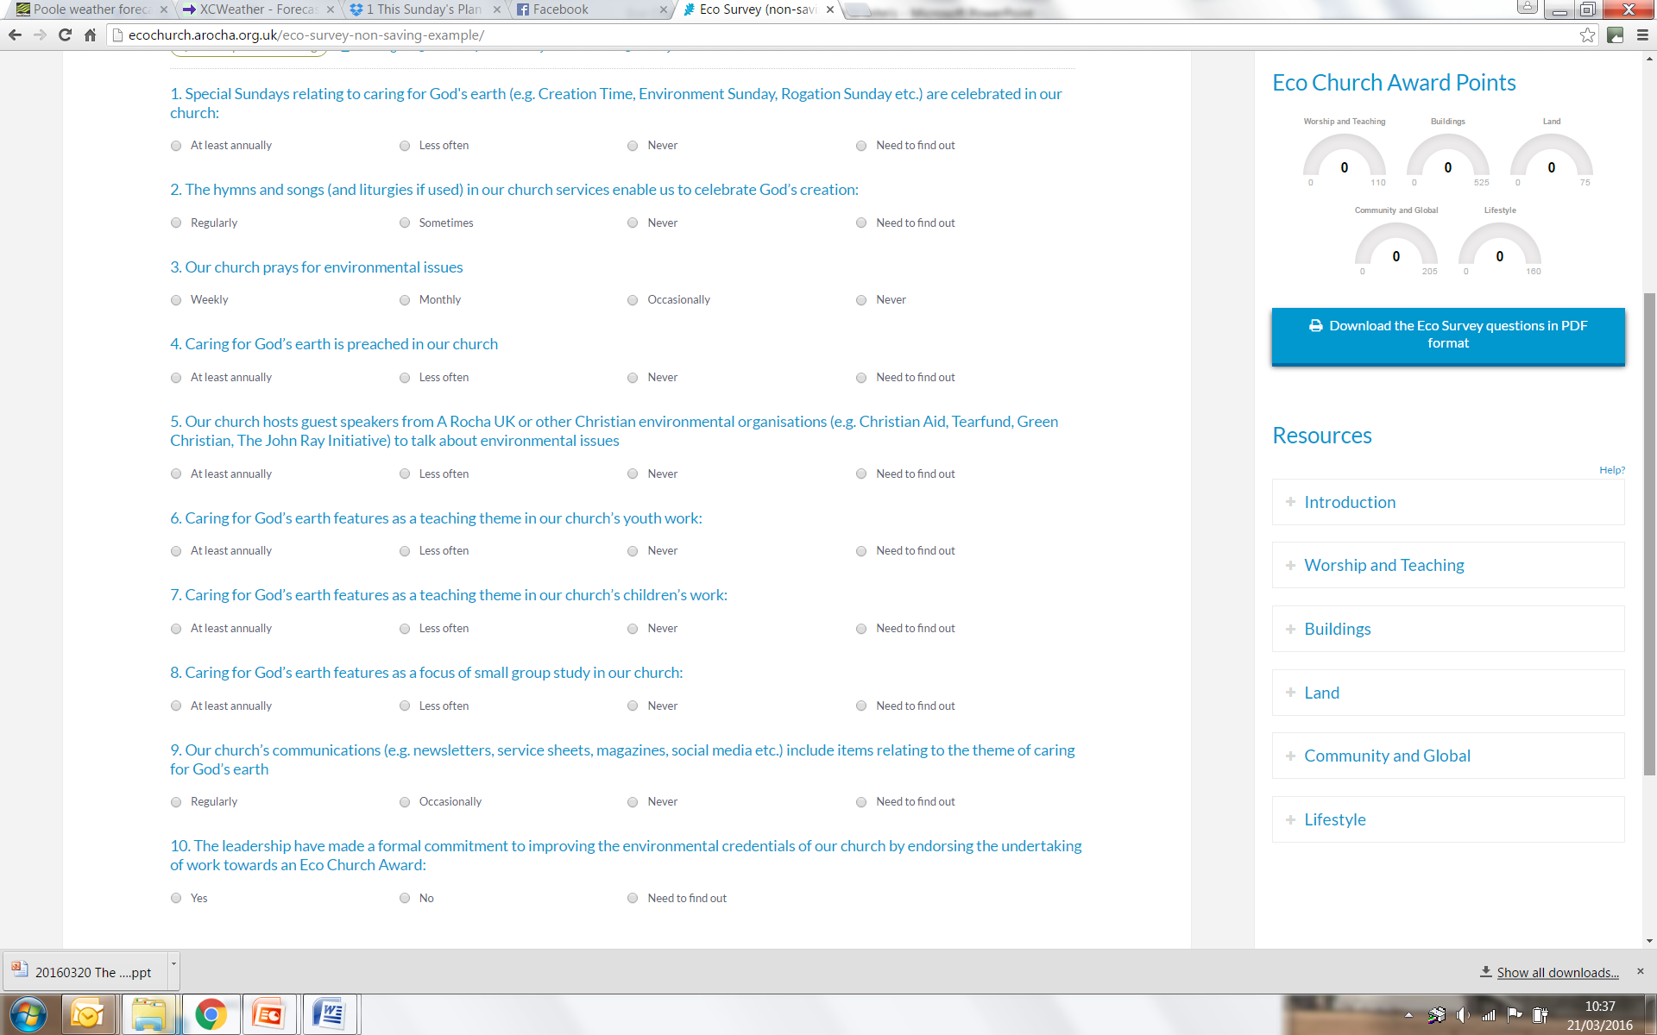
Notes:
At the heart of Eco Church is a unique online survey that enables congregations to record their progress and plan future initiatives.

Slide 8
Online use of survey

Slide 9
Does that seem workable?

Slide 10
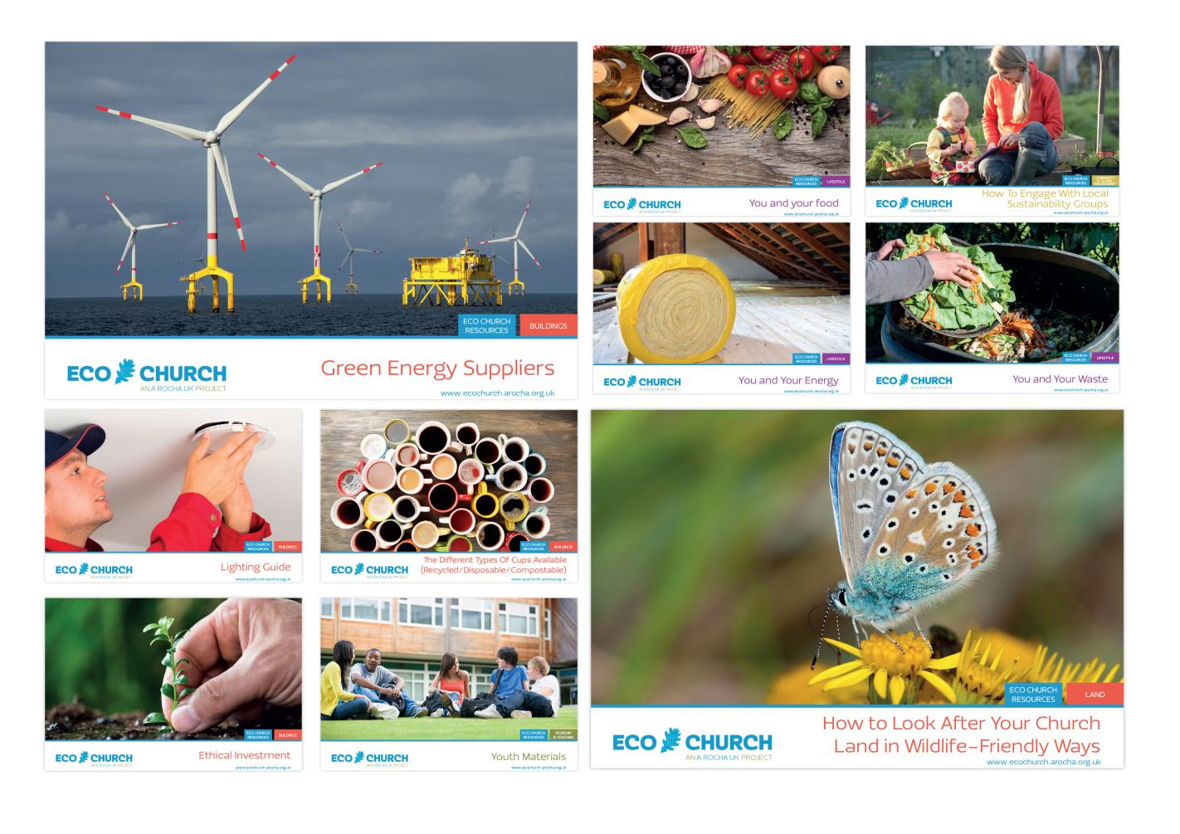

Slide 11
Eco Church Award Points

Slide 12
Current state of Eco Church
Nearly 900 churches registered
More than 200 awards
Survey modified last year to make it more flexible to church circumstances

Slide 13
Register NOW at:
www.ecochurch.arocha.org.uk
Why not get stuck in and give it a go?
Notes:
Not going to harvest your data! Grasp this agenda to work to.
Leaflets and slides (and words) available for you to use

Slide 14
Your Questions?

Slide 15
My experience - Eco Church
A rather conservative evangelical church – little interest
Eco Congregation failure some 6 +years ago!!
I did the survey from what I know
Small group established
Approached PCC
PCC supported proposal to engage with Eco Church
Churchwardens spoke and voted against it!!
Four of us surveyed ‘now’ situation
Worried about how to do now & future with those directly involved
In practice discussed ‘now’ and naturally got the ‘future’
Established a full ‘now’ situation and ‘future’ possibilities
Came back to PCC report and plan of action (to do the we should.)

Slide 16
My experience -Eco Church (2)
PCC supported these actions
Small group worked individually on each requirement to reach ‘future’
Key agreement was a series of sermons on Creation in Creationtide
Produced green card for personal actions
Group met periodically to share & encourage
Achieved award
Need to celebrate success – working on it
Moving on towards silver

Slide 17
Not required

Slide 18
Learning points
Involve those who are responsible in each area
Now & Future concurrently
Not a committee, an action group as necessary
Not all the PCC may be keen to engage
Adapt your approach
Teaching is key – sermon(s), small groups
Green card to help individuals with practical actions
Keep the leadership in the loop
Celebrate success

