Slide 1
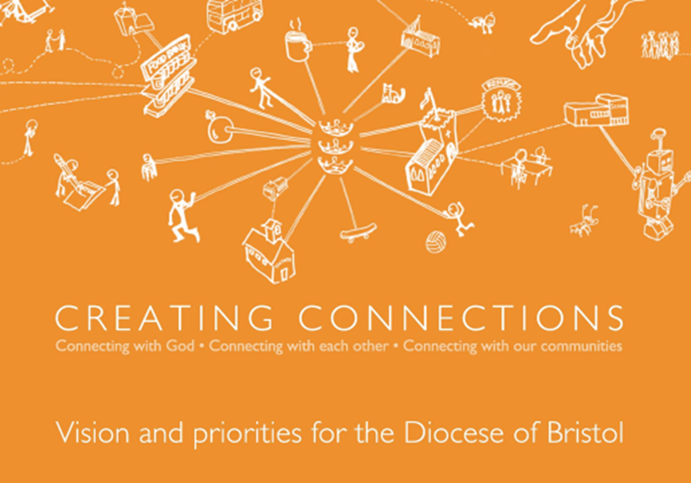

Slide 2
Creating connections is our response to Jesus’ invitation to see His ‘big idea’ of the Kingdom of God become a reality.
+Mike

Slide 3
To be what Bishop Mike describes as ‘a life changing movement’, we must be committed, confident and connected.

Slide 4
Our vision:
Connecting with God
Connecting with each other
Connecting with our communities
Prioritising:
Making disciples
Growing leaders
Engaging younger generations

Slide 5
Connecting with God
For Christians, to be connected with God is primarily about being, as St Paul would have put it, ‘in Christ’.

Slide 6
Connecting with Each Other
To be connected with each other means to reflect the unity and the diversity of the Holy Trinity within the Body of Christ. This unity in diversity can be experienced at every level within the Church.

Slide 7
Connecting with our Communities
To be connected with our communities is to be a incarnational Church. This means we have to start with people where they are, not where we might like them to be.

Slide 8
Priority 1:
Making Disciples
We need to encourage greater commitment to following Jesus in discipleship and to take seriously the call of the Great Commission.

Slide 9
Priority 2:
Growing Leaders
Leaders make a difference. We need to be intentional about rearing the right kind of leaders, lay and ordained, who are fit for the challenge of re-connecting in a post-Christian context.

Slide 10
Priority 3:
Engaging Younger Generations
To fulfil our call to proclaim afresh the Good News in each generation, we need to connect far more effectively with those aged 40 and under.

Slide 11
Making Disciples
What’s working well in our parish – enabling people to encounter Christ, become disciples and grow in faith?
Growing Leaders
What ideas have we got and tried for growing emerging leaders in all areas of ministry?
Engaging younger generations
How have we done this in our parish and what’s the dream for the future?

Slide 13
